Slide 1
SECURE DATA HIDING IN STEGANOGRAPHY
CAPSTONE PROJECT
Presented By: ANANT KUMAR PANDEY
Student Name : ANANT KUMAR PANDEY
College Name & Department : TRIDENT ACADEMY OF TECHNOLOGY , BHUBNESWAR , COMPUTER SCIENCE

Slide 2
OUTLINE
Problem Statement
Technology used
Wow factor
End users
Result
Conclusion
Git-hub Link
Future scope

Slide 3
Problem Statement
In today's digital world, ensuring secure communication is crucial. This project focuses on using steganography to hide messages within images, enhancing privacy and security through encryption.

Slide 4
Technology used
Libraries: OpenCV, Tkinter, PIL Language: Python Platform: Windows, Linux

Slide 5
Wow factors
Password-Protected Steganography – Ensures only authorized users can decrypt messages.
User-Friendly GUI – Simple interface for easy encryption and decryption.
Lightweight & Fast – Efficient image processing without significant quality loss.
Secure Data Hiding – Conceals messages within images without raising suspicion.

Slide 6
End users
Cybersecurity Professionals – For secure data transmission.
Privacy-Conscious Individuals – To protect sensitive information.
Researchers & Students – For learning and experimenting with steganography.
Journalists & Whistleblowers – To securely communicate confidential information.

Slide 7
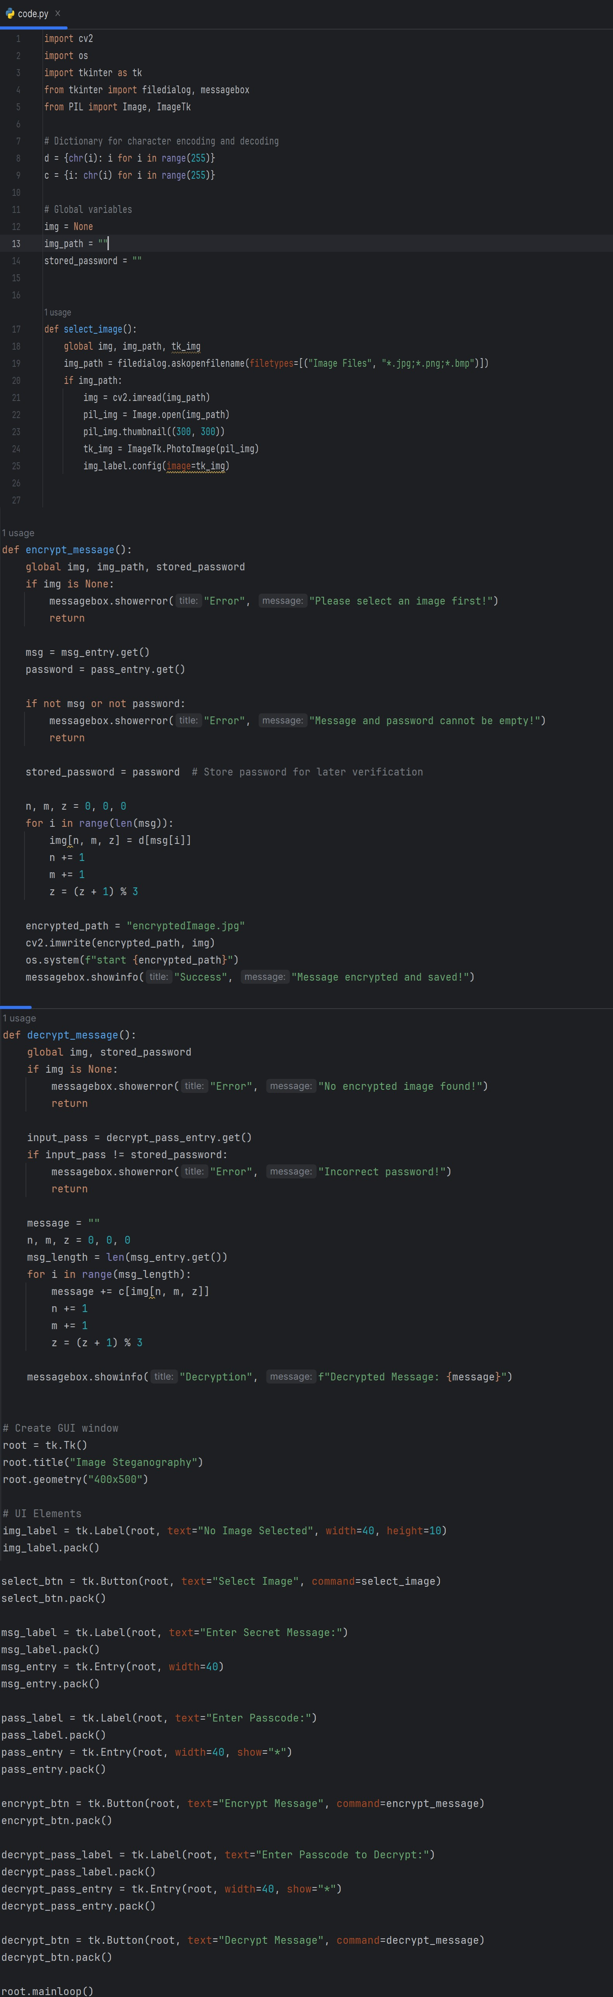
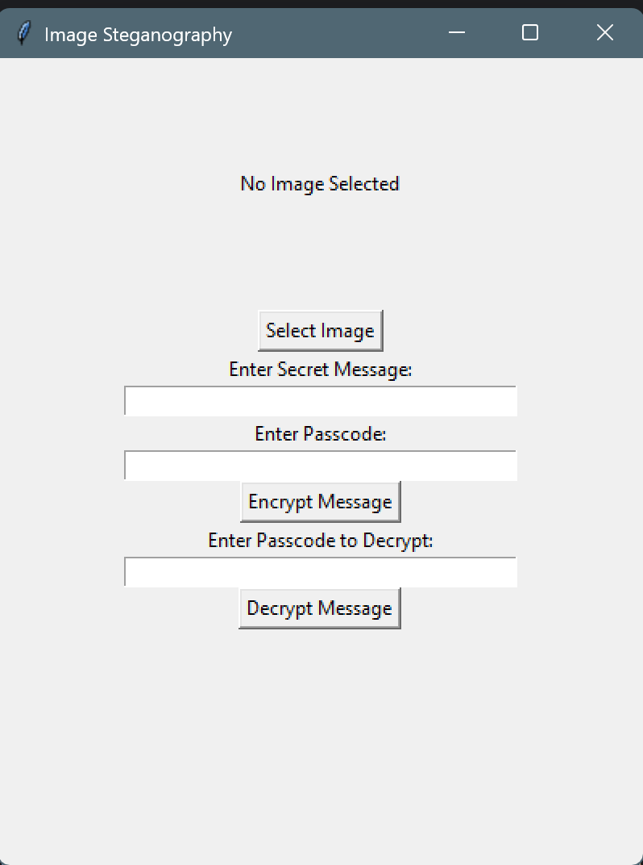
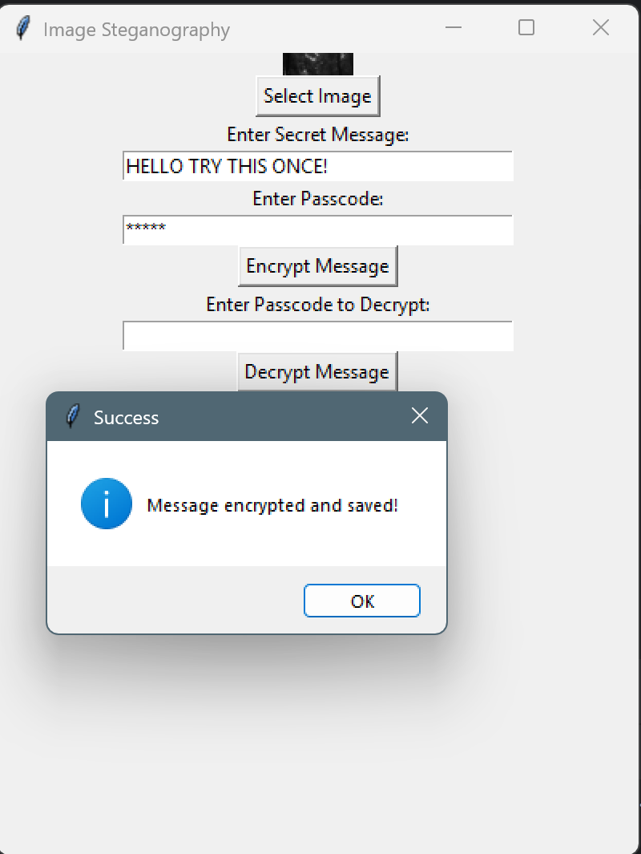
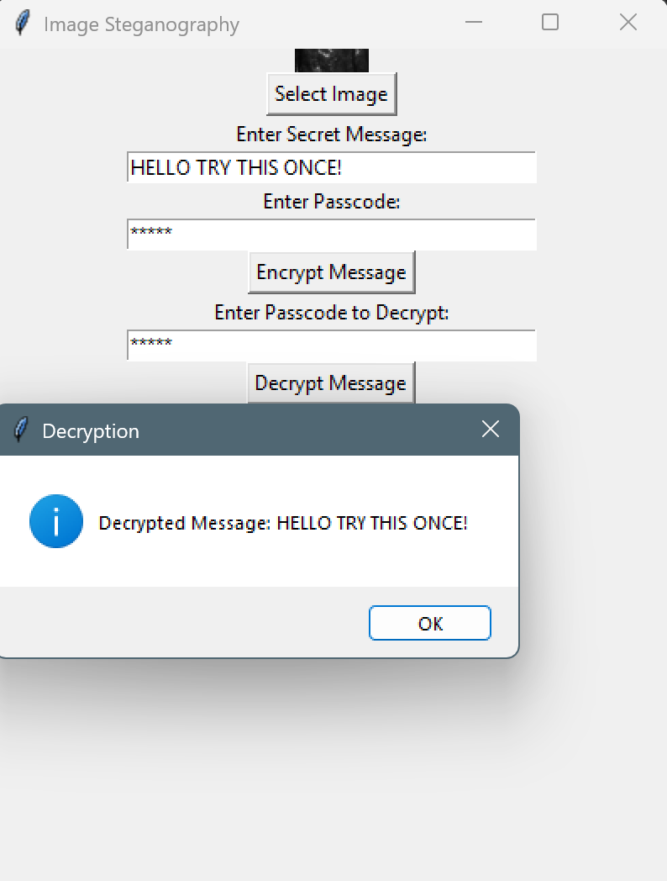
Results

Slide 8
Conclusion
This project successfully demonstrates secure data hiding using image steganography. By embedding messages within images and protecting them with a password, it ensures confidentiality and prevents unauthorized access. The user-friendly GUI makes encryption and decryption accessible to all, providing a practical solution for secure communication in personal and professional use.

Slide 9
GitHub Link
GITHUB: https://github.com/ScriptAnant/STEGANOGRAPHY

Slide 10
Future scope(optional)
Support for Multiple File Formats – Extend compatibility beyond images (e.g., audio, video).
Enhanced Encryption – Implement stronger encryption algorithms for added security.
Steganalysis Resistance – Improve methods to avoid detection by steganalysis tools.
Cloud Integration – Enable secure online storage and sharing of steganographic images.
Mobile Application – Develop a mobile-friendly version for wider accessibility.

Slide 11
THANK YOU

